Slide 1
Relativity Theory by Hajnal Andréka, István & Péter Németi
A Logic Based
Foundation and Analysis of
Notes:
GR and BH theory are extremely exciting, new frontier areas of science. It is an inviting application area for logic and logicians. We claim that logic can be fruitfully applied in this field. In this talk we would like to show you how.

Slide 2
Welcome
Our Research Group:
  H. Andréka, J. X. Madarász, I. & P. Németi,
  G. Székely, R. Tordai.
  Cooperation with:
  L. E. Szabó, M. Rédei.
Notes:
This is the core of our research group

Slide 3
Aims of our school
Analysis of the logical structure of R. Theory
Base the theory on simple, unambiguous axioms with clear meanings
Make Relativity Theory:
  More transparent logically
  Easier to understand and teach
  Easier to change
  Modular
Demystify Relativity Theory
Notes:
In our research group,
We are working on a logic based approach to relativity, and related areas like BH physics, wormholes, cosmology. There are 2 uses of such an aproach:
1. One is foundational. We build a logic based foundation for relativistic physics in the style of the success story of FOM. We use methods from FOM and reverse mathematics.
2. The second use is demystifying RT, moreover making it accessible for logicians without assuming any background in physics.
-We want to obtain deeper understanding of R.T.
We want to analyze the axiomatic structure of the theory
We want to base the theory on simple, unambiguous axioms, with clear transparent meaning
The theory should be built up from these in a straightforward, logical manner
We want to make R.T. more transparent logically, easier to understand, easier to change, modular and easier to teach.

Slide 4
PLAN of OUR presentations
  Logical analysis of:
  Special relativity theory
      Transition to:
  Accelerated observers and Einstein's EP
      Transition to:
  General relativity
  Exotic space-times, black holes, wormholes
  Application of general relativity to logic
  Visualizations of Relativistic Effects
  Relativistic dynamics, Einstein’s E=mc²
SpecRel
AccRel
GenRel

Slide 5


Aims of our school
R.T.’s as theories of First Order Logic
S. R.
G. R.
Notes:
We build up R.T.’s as theories in the sense of logic.
Actually our R.T’.s will be theories of First Order Logic.
We use plain FOL (First Order Logic) as in FOM (Foundation of Mathematics)
Leather-bound boxes official theories

Slide 6

Logic axiomatization of R.T.
Theorems
Thm …
Thm …
Thm …
Thm …
Thm …
Thm …
Axioms
Proofs
Ax….
Ax….
Ax….
Ax….
…
Streamlined
Economical
Transparent
Small
Rich
Notes:
The price-value ratio is high.
Surprising, shocking, paradoxical predictions of RT as theorems and not as axioms.
Key point: no fancy statements among the axioms.

Slide 7

Language for specrel
Bodies (test particles), Inertial Observers, Photons, Quantities, usual operations on it, Worldview
B
Q = number-line
IOb
Ph
W
0
Notes:
Our first example is SR.
There are many other incarnations of RT which we investigate e.g. GR, but we have to start somewhere.
In SR there are two basic kinds of entities one can talk about, these are test particles B, and quantities (numbers) Q.
The physical and the mathematical universes.

Slide 8

Language for specrel
W(m, t x y z, b) ⬄ body “b” is present at coordinates “t x y z” for observer “m”
m
t
b (worldline)
x
y
Notes:
Axiom 0: Every inertial observer coordinates his world by 4 coordinates, 1 time coord. and 3 space coord.s
This axiom is built into the language
Worldview
Worldline: body b is present for observer m at these coordinates

Slide 9


Axioms for specrel
AxField
Usual properties of addition and multiplication on Q :
Q is an ordered Euclidean field.
1. ( Q , + , ∙ ) is a field in the sense of abstract algebra
(with 0 , + , 1 , / as derived operations)
2.
3.
Ordering derived:
Logic Colloquium, Sofia, July 31 – August 6 2009
Notes:
Ordered Euclidean field means that positive members have square roots.
They are called Euclidean fields because of their role in Tarski's FOL axiomatization of Euclidean geometry.
This is a „mathematical” axiom, physicists use it tacitly.

Slide 10

Axioms for specrel
AxPh
For all inertial observers the speed of light is the same in all directions and is finite.
In any direction it is possible to send out a photon.
t
Formalization:
ph₁
ph₂
ph₃
x
y
Notes:
This axiom is the outcome of the M&M experiment.
Besides M&M this is being tested since then, nowadays it is tested by GPS technology.
Key axiom, with a physical meaning.

Slide 11



Axioms for specrel
What is speed?
m
p_{t}
b
p
1
q_{t}
q
v_{m}(b)
q_{s}
p_{s}
Notes:
Vm(b) = speed of b relative to m
Space-component, time-component
This is how we formalize speed by using the field-structure of our theory

Slide 12
Axioms for specrel
AxEv
All inertial observers coordinatize the same events.
t
t
m
b₁
k
b₁
b₂
b₂
W_{m}
W_{k}
x
x
y
y
Formalization:
Notes:
These bodies are possible bodies (=test particles).
The same events exist for all observers.
„sees” = coordinatizes
This axiom connects the worldviews of different observers, it says that they talk about the same outside reality.

Slide 13
Axioms for specrel
AxSelf
An inertial observer sees himself as standing still at the origin.
m
t
t = worldline of the observer
W_{m}
x
y
Formalization:
Notes:
The last two axioms are „book-keeping”, simplifying axioms. We could leave them out and nothing would be lost, only the formalizations of the theorems would become more complicated.

Slide 14


Axioms for Specrel
AxSymd
Any two observers agree on the spatial distance between two events, if these two events are simultaneous for both of them, and |v_{m}(ph)|=1.
m
t
t
ph
k
x
e1
x
Formalization:
e2
y
y
is the event occurring at p in m’s worldview
Notes:
Symmetry axiom: all observers use the same units of measurements.
Simplifying axiom.
SpecRel without symmetry axiom already proves all the important predictions of usual special relativity with the only exception that in SpecRel0 different observers might use different units of measurements. The assumption that all observers use the same units of measurements is clearly of a book-keeping nature only and therefore it is expendable. So we could, in principle, regard SpecRel without AxSym as the full theory of SR. However, this would lead to complicated formulation of the important theorems and the complications would go in a completely irrelevant direction. Therefore we add to SpecRel without AxSym the so-called symmetry axiom, a simplifying principle. It is important to note that the symmetry axiom has no deep physical content, it is only conventional, by assuming it we do not use any relevant information.

Slide 15
Specrel
SpecRel = {AxField, AxPh, AxEv, AxSelf, AxSymd}
Theorems
Thm1
Thm2
Thm3
Thm4
Thm5
SpecRel
AxField
AxPh
AxEv
AxSelf
AxSymd
Proofs
…
Notes:
5 axioms, AxPh is the most important one of them

Slide 16




Specrel
Thm1
Thm2
Notes:
V_m(k) is the velocity of k as seen by m.
This will be our generic example for "fancy theorem" from "plain axioms“.
Analog case will be E=mc^2 in place of NoFTL.
“Why type” questions
NoFTL is removed from the cost-side and is put on the gain-side.

Slide 17
Specrel
  Proof of Thm2 (NoFTL):
Tangent plane
- AxField
ph
- AxPh
ph1
t
ph
k
- AxSelf
k
e2
t
- AxEv
m
q
e3
p
e2
e1
e1
ph1
x
x
y
y
k asks m : where did ph and ph1 meet?

Slide 18
Specrel
Thm3
  SpecRel is consistent
Thm4
  No axioms of SpecRel is provable from the rest
Thm5
  SpecRel is complete with respect to Minkowski geometries
  (e.g. implies all the basic paradigmatic effects of Special Relativity - even quantitatively!)
Notes:
Theorems 3,4 show what we cannot prove from SpecRel.
Them 5 shows what we CAN prove from SpecRel. It is a completeness theorem for SR.
The completeness theorem for SR is a completeness theorem in the usual sense of logic, namely it says that SR is complete wrt its “standard model”, or “intended model”, i.e. wrt Minkowskian geometry.
This theorem already implies the so-called paradigmatic effects of SR, e.g. the fact that “moving clocks run slow”, and that “moving clocks get out of synchronism”. Despite of this fact, we prefer to prove the paradigmatic effects one-by-one, directly from the axioms of SR because this illuminates or illustrates how we perform our conceptual analysis. These proofs can be found on our homepage, we will be happy to show them to anyone interested.

Slide 19
Specrel
Thm6
  SpecRel generates an undecidable theory. Moreover, it enjoys both of Gödel’s incompleteness properties
Thm7
  SpecRel has a decidable extension, and it also has a hereditarily undecidable extension. Both extensions are physically natural.

Slide 20
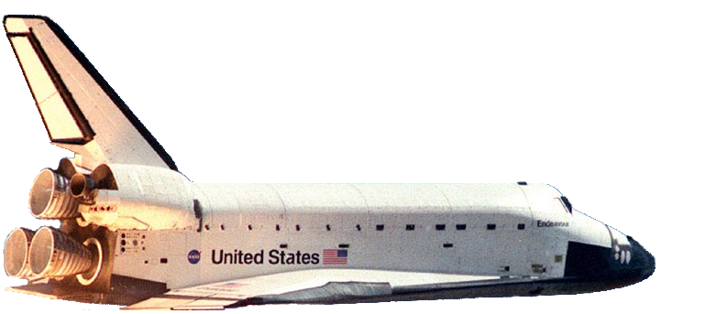


Relativistic effects
Thm8
v_{k}(m)
Moving clocks get out of synchronism.
Notes:
This has deep philosophical consequences. E.g. there is no such thing as absolute present. Mixes time and space.
This is a highly important thm, since most of the fancy, exciting things in Relativity and Cosmology are based on this Thm!
Like in models of set theory: external properties and internal properties
Contradicts common sense
Paves the road for proving completeness theorem

Slide 21



Moving clocks get out of synchronism
Thm8 (formalization of clock asynchronism)
Assume SpecRel. Assume m,k ϵ IOb and events e, e’ are simultaneous for m,
(1) Assume e, e’ are separated in the direction of motion of m in k’s worldview,
k
m
m
1_{t}
v
x_{m}
e’
e
|v|
e
e’
1_{x}
x_{k}
x_{m}
y_{k}
Notes:
Experiment for testing simultaneity for m

Slide 22
Moving clocks get out of synchronism
(2) e, e’ are simultaneous for k, too
e, e’ are separated orthogonally to v_{k}(m) in k’s worldview
k
m
x_{m}
e
x_{k}
e’
y_{m}
y_{k}
Notes:
Events separated orthogonally to the motion do not get out of synchronism

Slide 23
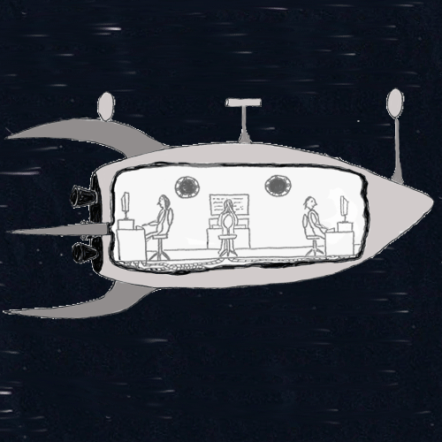
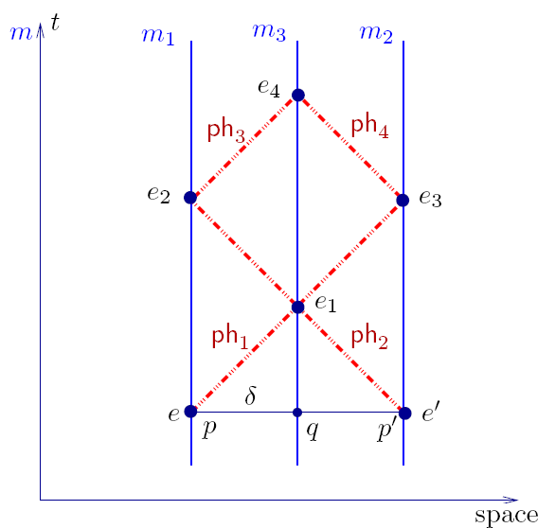
Moving clocks get out of syncronism
Thought-experiment for proving relativity of simultaneity.
Notes:
This is the worldview of the ship. The captain is sitting in the middle of the ship and sends photon-signals to two mirrors, one at the nose and one at the rear of the ship. These two signals bounce on the mirrors and arrive back to the captain at the same time. This is how the captain knows that he is sitting exactly in the middle of the ship. By the photon-axiom the forward going and backward going photons travel with the same speed, thus the two bouncing events happen at the same time in this ship.
On the lelft-hand side there is the space-time diagram for the situation.

Slide 24
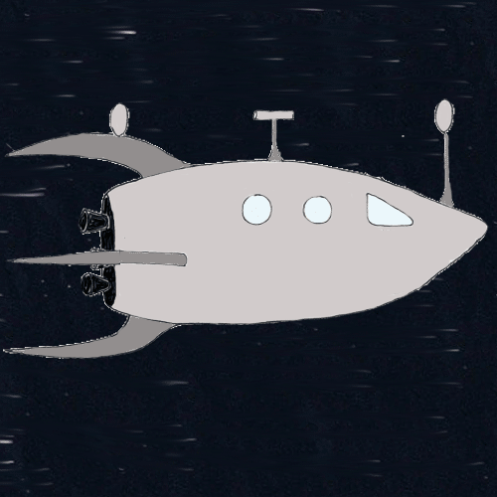
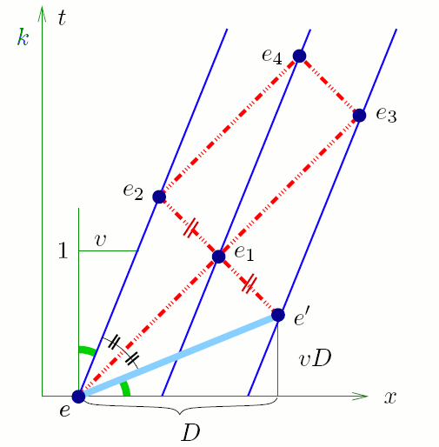
Moving clocks get out of syncronism
Thought-experiment for proving relativity of simultaneity.
Notes:
This is the worldview of an observer moving relative to the ship, lets call him Earthling. So this ship is moving in this worldview. We are following it with our camera, thats why it stays in the middle of the picture. Now by the photon-axiom, the Earthling sees the forward and backward moving photons move with the same speed. Since the ship moves in this worldview, the forward going photons race with the ship, thus the photons move slowly relative to the ship. By the same token, the backward going photons move very fast relative to the ship. By the event axiom, they meet where the captain sits, hence in the middle of the ship in this worldview, too. Therefore in this worldview the nose-bouncing event has to take place later than the rear-bouncing event.

Slide 25
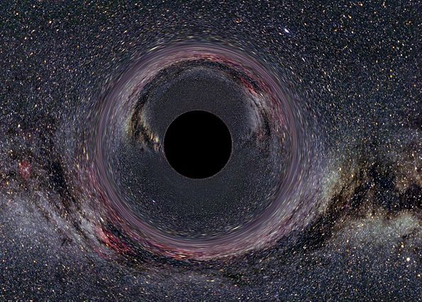
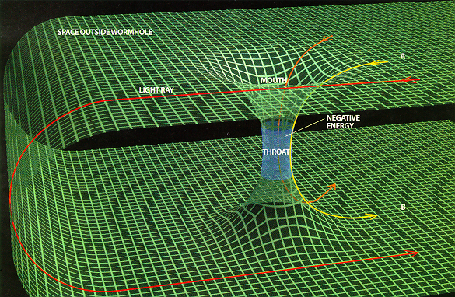
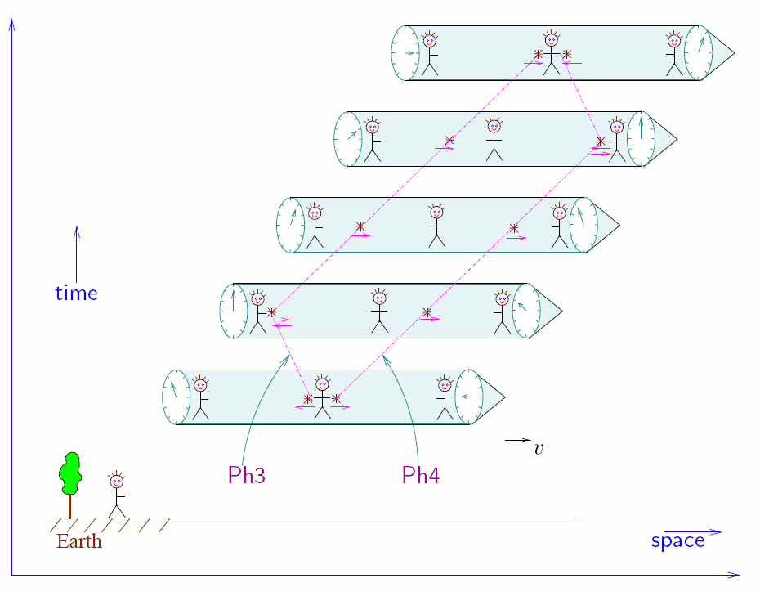

Moving clocks get out of syncronism
Black Hole
Wormhole
Timewarp-theory
Logic Colloquium, Sofia, July 31 – August 6 2009
Notes:
As a consolation, “present” becomes a defined, “testable” concept. (half-simultaneity)
This leads up to black-hole, wormhole, timewarp-theory (via Einstein`s equivalence principle).
Shows that time and space get mixed.

Slide 26

Relativistic effects
Thm9
Moving clocks slow down
Moving spaceships shrink
Notes:
These are the other two paradigmatic effects of relativity theory. They can be stated and proved analogously to the previous one. The three effects prove the next theorem, which is the key in proving the completeness theorem. We skip the formal statements and proofs of these two paradigmatic effects.

Slide 27

Moving clocks slow down
Thm9 (formalization of time-dilation)
Assume SpecRel. Let m,k ϵ IOb and events e, e’ are on k’s lifeline.
k
m
k
e’
e’
v
1
e
e
x_{k}
x_{m}
Notes:
K measures less time between e and e’ than m. In other words, k’s clocks run slow as m observes it.

Slide 28
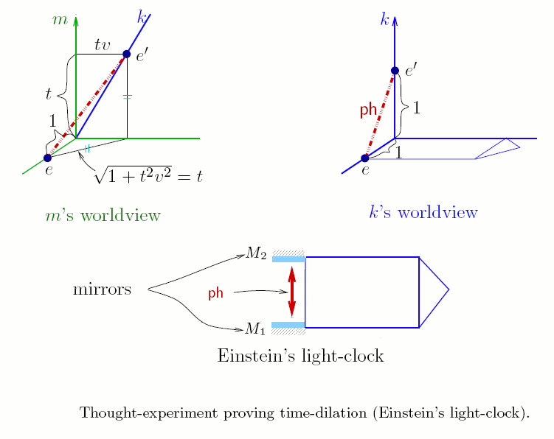
Moving clocks slow down
Notes:
Proof of relativistic time dilation

Slide 29


Moving spaceships shrink
Thm10 (formalization of spaceship shrinking)
Assume SpecRel. Let m,k,k’ ϵ IOb and assume
m
k
k’
k
k’
e
e’
x_{m}
x
Notes:
Relativistic length contraction

Slide 30
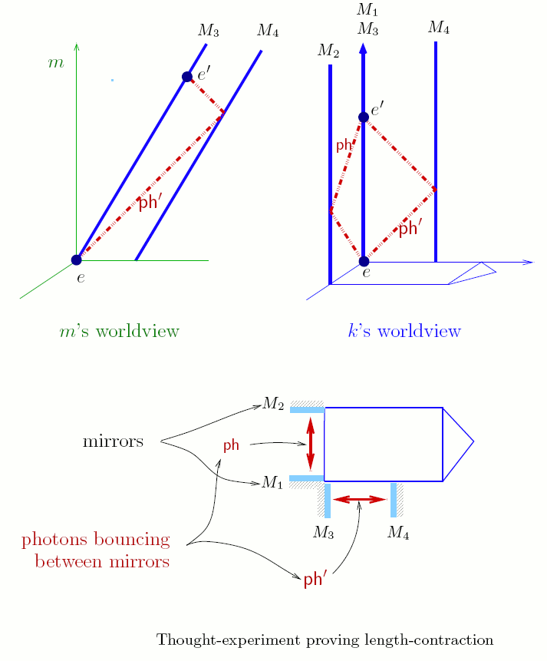
Moving spaceships shrink
Notes:
Proof of relativistic length contraction

Slide 31
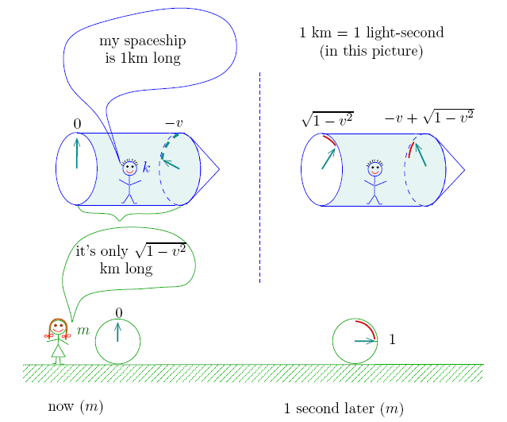

Relativistic effects
v = speed of spaceship
Notes:
v = speed of spaceship
Quantitatively, too.

Slide 32
Worldview transformation
t
w_{mk}
t
m
b₁
k
b₁
p
b₂
q
b₂
W_{m}
W_{k}
x
ev_{m}
ev_{k}
x
y
y
Notes:
W_mk = ev_m circle ev_k^{-1},
w_mk is a binary relation between coordinate systems
comparison between two maps of the same city

Slide 33

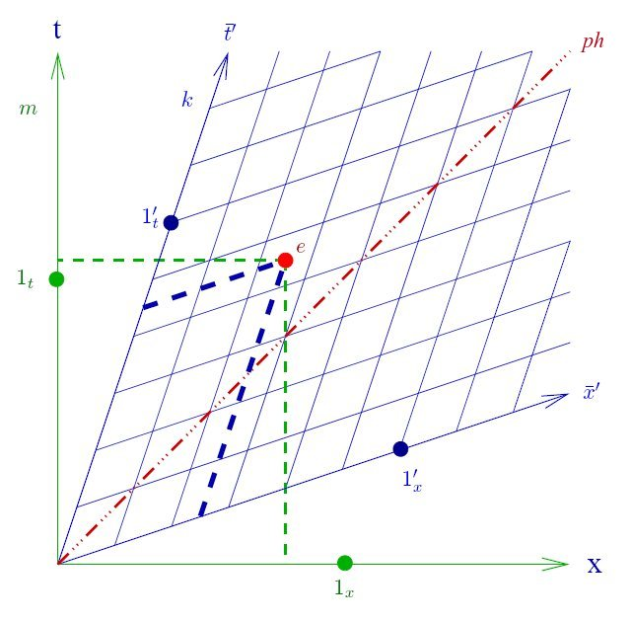
specrel
Thm11
  The worldview transformations w_{mk} are Lorentz transformations (composed perhaps with a translation).
Notes:
K’s coordinate system drawn into m’s coordinate system

Slide 34
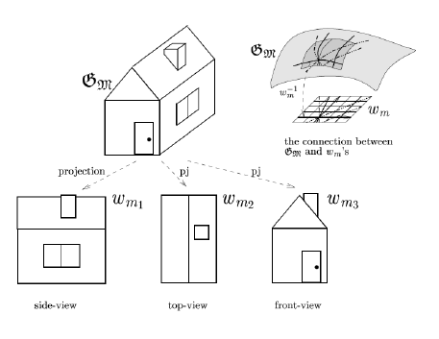
Other formalisations of specrel
Minkowskian Geometry:
Hierarchy of theories. Interpretations between them. Definitional equivalence.
Contribution of relativity to logic: definability theory with new objects definable
(and not only with new relations definable). J. Madarasz’s dissertation.
Notes:
Descriptive geometry

Slide 35
specrel
Conceptual analysis of SR goes on … on our homepage
New theory is coming:
Notes:
We have to interrupt studying this theory in this talk since we want to go on towards general relativity theory.

Slide 36
Theory of Accelerated observers
AccRel = SpecRel + AccObs.
AccRel is stepping stone to GenRel via Einstein’s EP
Accelerated Observers
S. R.
G. R.
AccRel
AccRel
SpecRel
GenRel
Notes:
enrichment of SpecRel with accelerated observers.
Accrel: also theory explaining how the relativistic paradigmatic effects develop.
AccRel makes transition more organized, smaller leap.

Slide 37



Language for accrel
The same as for SpecRel.
Recall that
Notes:
W_mk = ev_m circle ev_k^{-1},
w_mk partial function between coordinate domains

Slide 38
Language for accrel
t
Cd(m)
t
Cd(k)
m
b₁
w_{mk}
k
b₁
b₂
b₂
W_{m}
W_{k}
x
ev_{m}
ev_{k}
x
y
y
World-view transformation
Notes:
W_mk = ev_m circle ev_k^{-1},
w_mk partial function between coordinate domains

Slide 39

Axioms for accelerated observers
AxCmv
At each moment p of his worldline, the accelerated observer k “sees”
(=coordinatizes) the nearby world for a short while as an inertial observer m
does, i.e. “the linear approximation of w_{mk} at p is the identity”.
kϵOb
p
mϵIOb
Formalization:
Let F be an affine mapping (definable).
Notes:
Key axiom of AccRel. Ties the behavior of accelerated observers to those of inertial ones.
Says that not only their lifelines agree for an infinitely short while but also their worldviews agree for that infinitely short time. I.e. their worldviews are also tangent. Way of saying this: the worldview transformation is (almost) the identity, ie its linear approximation is the identity.
Worldline of k is curved, m is tangent inertial observer, m and k move together at p
Dropped spacepod, switched-off engine
Thought experiment. Error of approximation

Slide 40
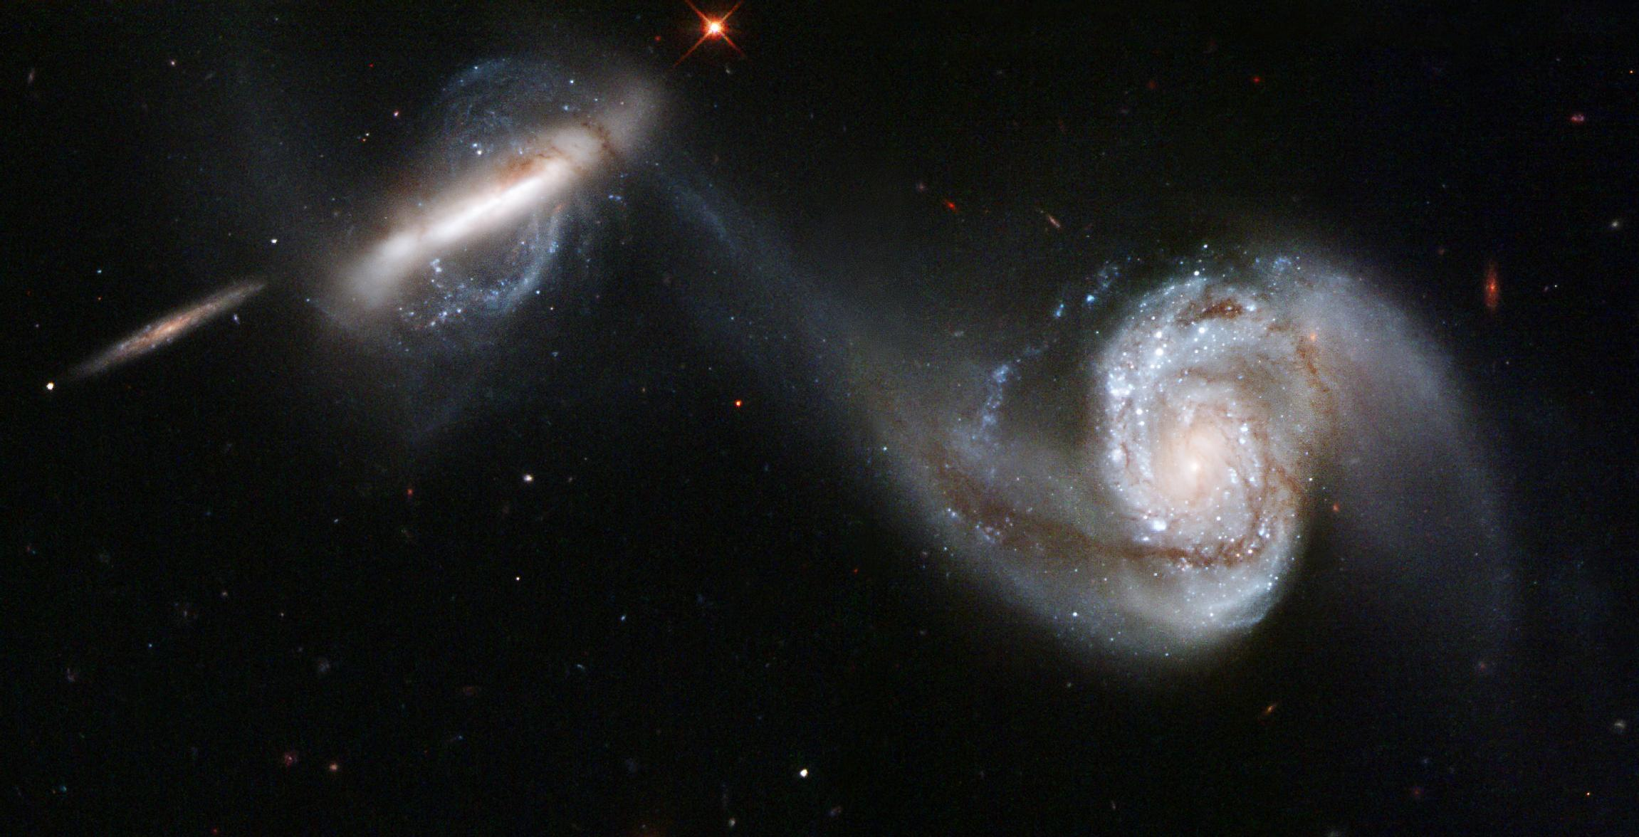
Thought experiment
The Vienna Circle and Hungary, Vienna, May 19-20, 2008

Slide 41
Thought experiment

Slide 42
Axioms for accelerated observers
  AxEv⁻
If m “sees” k participate in an event, then k cannot deny it.
t
t
m
k
k
b₂
b₂
W_{m}
W_{k}
x
x
y
y
Formalization:
Notes:
The rest of the axioms are weaker versions of axioms of SpecRel postulated now for ALL observers
(SpecRel talks only about inertial observers)

Slide 43


Axioms for accelerated observers
AxSelf ⁻
    The world-line of any observer is an open interval of the time-axis, in his own world-view
AxDif
    The worldview transformations have linear approximations at each point of their domain (i.e. they are differentiable).
AxCont
    Bounded definable nonempty subsets of Q have suprema. Here “definable” means “definable in the language of AccRel, parametrically”.
Notes:
AxDif excludes crazy motion.
AxCont is a reinforcement of AxDif: if the numberline has gaps then still there can be crazy motion
The axiom scheme of continuity is a “mathematical axiom”, and it is completely analogous to Hilbert’s continuity axiom in his axiomatization of geometry. More precisely, it is the Tarskian version. It says that all definable nonempty bounded subsets of Q have suprema. Here definable means “definable in the language of AccRel, parametrically”. The only reason why we need this axiom is that it is not a FOL property to say that Q,+, is the usual real number-line.

Slide 44
Accrel
AccRel = SpecRel + AxCmv + AxEv⁻ + AxSelf ⁻ + AxDif + AxCont
AccRel
Theorems
AxField
AxPh
AxEv
AxSelf
AxSymd
AxCmv
AxEv⁻
AxSelf ⁻
AxDif
AxCont
Thm101
Thm102
Thm103
Thm104
…
Proofs
Notes:
10 axioms
The explicite introduction and development of AccRel as a theory of its own right is a contribution of our group.
It has many purposes and uses.
Smooth transition to GR
Checking which predictions of GR are already provable for AccRel (there are many such)
About the non-existent theory of quantum-gravity QG we mention that people trying to approximate QG tacitly use a combination of AccRel and QM. The reason for this is that SpecRel can be combined with QM and AccRel is a mild enough (or tame enough) extension of SpecRel.

Slide 45


Accrel
Thm101
IOb
t₁’
t₁
Ob
t
t’
  Appeared: Found. Phys. 2006, Madarász, J. X., Németi, I., Székely, G.

Slide 46
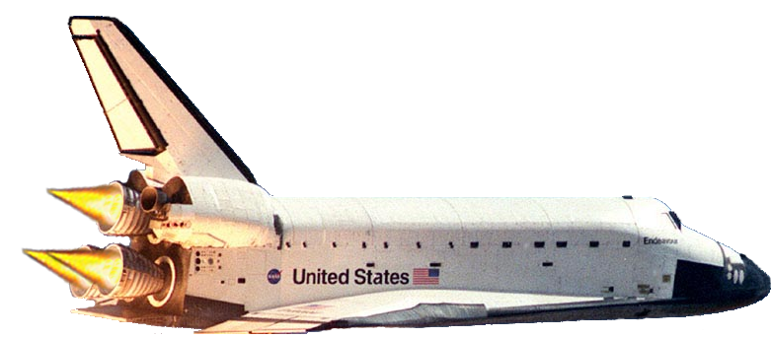

Accrel
Thm102
a_{k}(m)
Acceleration causes slow time.
Notes:
By „clock” we mean natural processes. Einstein’s light-clock.
This is sharply different from SR’s time dilation
Acceleration is not relative it is „absolute”
GTD will lead up to BH’s

Slide 47
Accrel
Thm102
  I.e., clocks at the bottom of spaceship run slower than the ones at the nose of the spaceship, both according to nose and bottom (watching each other by radar).
  Appeared: Logic for XXIth Century. 2007, Madarász, J. X., Németi, I., Székely, G.

Slide 48
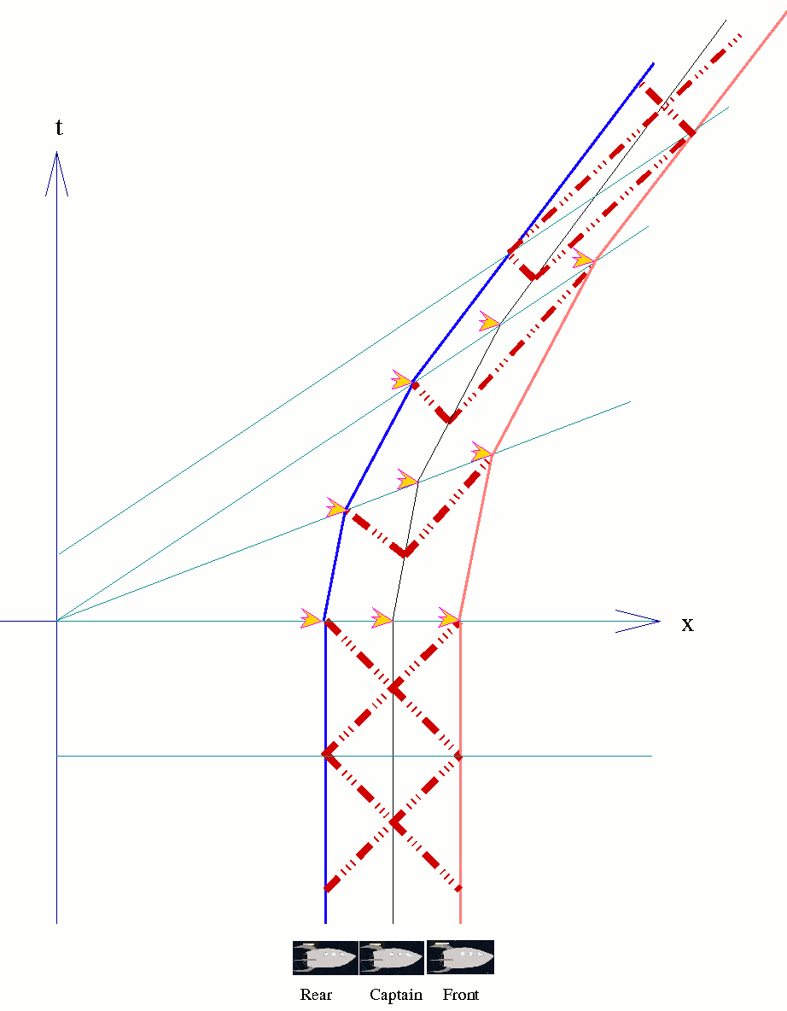
Accelerating spacefleet
Notes:
Proofidea: This is the worldview of an inertial observer. In the lower part of the spacetime diagram we see the spaceship from our first proof, motionless, captain sending out his synchronizing signals.
Since we know that this ship will accelerate, we broke it up into 3 independent ships, one ship for the captain in the middle, one for nose, and one for rear. So we have this fleet of ships. (This is how extended bodies are treated in relativity theory.)
At one point, the fleet gets the order to move to Vega, so the fleet has to accelerate. The utmost concern of the captain is to keep his fleet together, he wants to maintain constant radar-distance between members of his fleet. He uses his synchronizing signals for this purpose.
He sends out his synchronizing signals at regular intervals as until now, but now with each signal he sends an order to rear and nose to make one boost of acceleration. In captains worldview then rear and nose always make their boosts at the same time.
Since the fleet is now moving in the original inertial worldview, the respective boosts of rear and nose are not happening at the same time in this inertial worldview. Moreover, the line connecting the corresponding boosts of rear and nose get more and more tilted between two consecutive boosts. Between two such boosts rear and nose are moving with the same speed, so by the tilting, more time passes between two consecutive boosts at nose than at rear.
Thus in captains worldview, the boosts happen always at the same time, but between two consecutive boosts rear reports always less time happening than nose. Natural interpretation of this is that time runs faster at nose than at rear.
This gravitational time-dilation is the effect of acceleration, changing speed. As soon as acceleration stops, the two clocks begin to tick with the same rate again.
This proof relied on relativity of simultaneity only, relativistic time dilation and length contraction played no role in the proof.
Real proof from AccRel is the same, but „smoothing things out”.
Corollary: From behaviour of clocks we know how dropped apples will move.

Slide 49
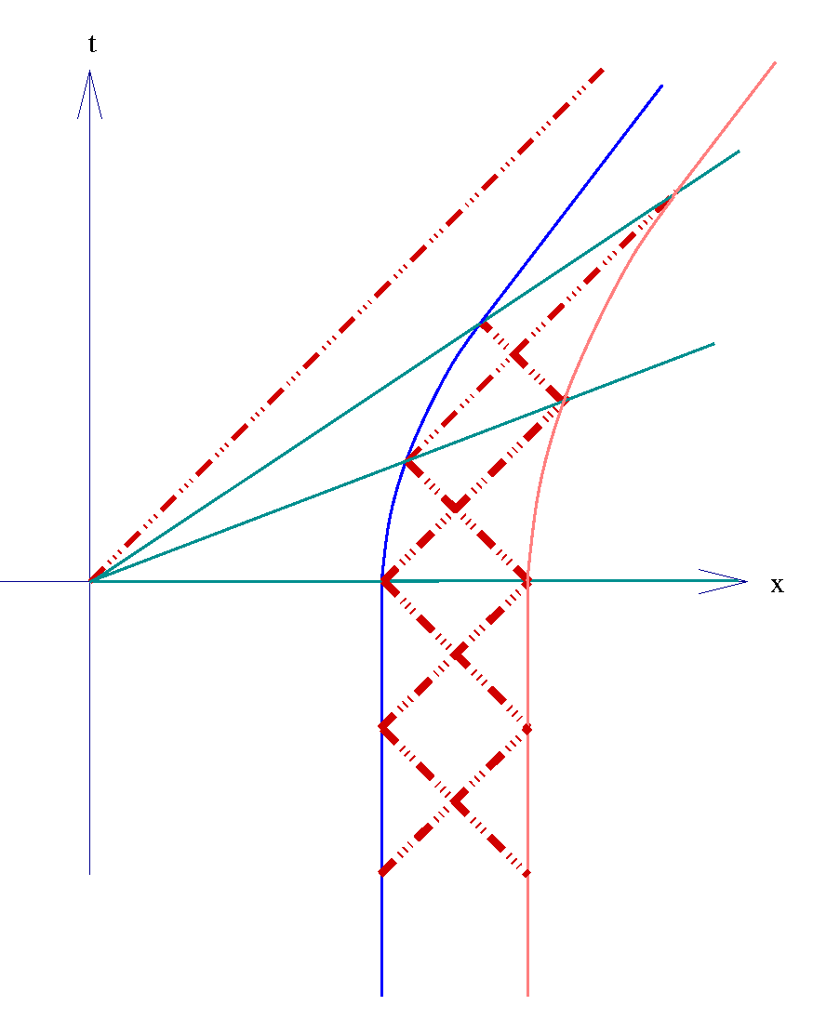
Accelerating spacefleet
Notes:
Smoothed out version.

Slide 50
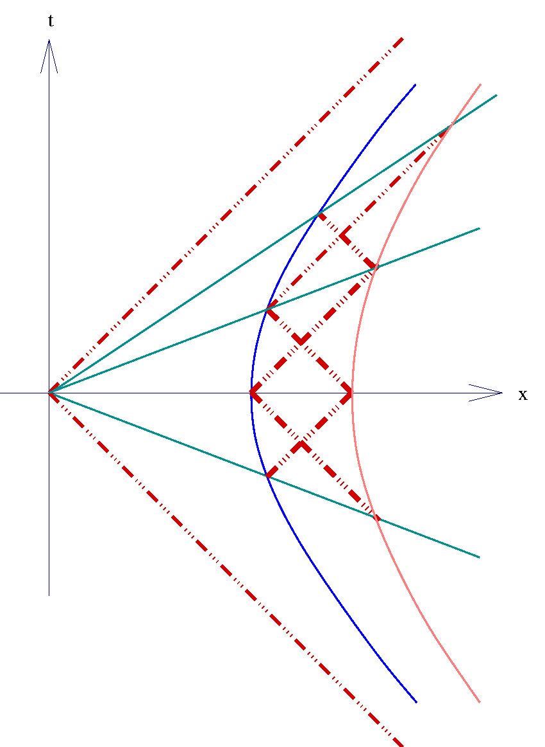
Accelerating spacefleet
Notes:
From AccRel it can be proved that the worldlines of uniformly accelerated observers are hyperbolas.
Formulation of acceleration: acceleration that the co-moving inertial observer measures.

Slide 51
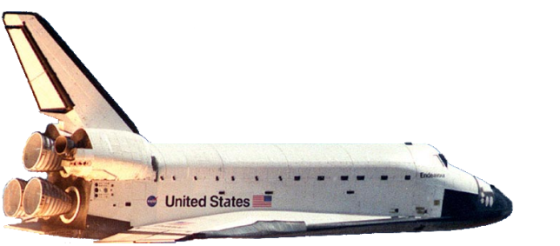

are the effects real?
-
-
-
-
-
-
+
-
+
-
+
-
-
-
-
-
-
-
-
-
-
+
-
+
-
+
-
-
-
-
Notes:
Communication between atoms by electromagnetic waves.

Slide 52
Accrel
Thm103
  Proof:
  We will present a recipe for constructing a world-view for any accelerated observer living on a differentiable “time-like” curve (in a vertical plane):
m
wline_{m}h
h
q
r
0
0
d
Notes:
Natural coordinate system of an accelerated observer.

Slide 53
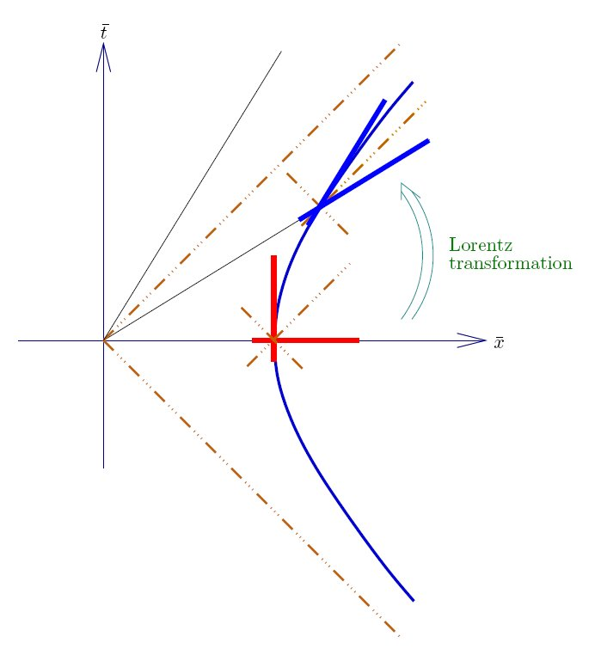
uniformly accelerated observers
World-lines are Minkowski-circles (hyperbolas)

Slide 54
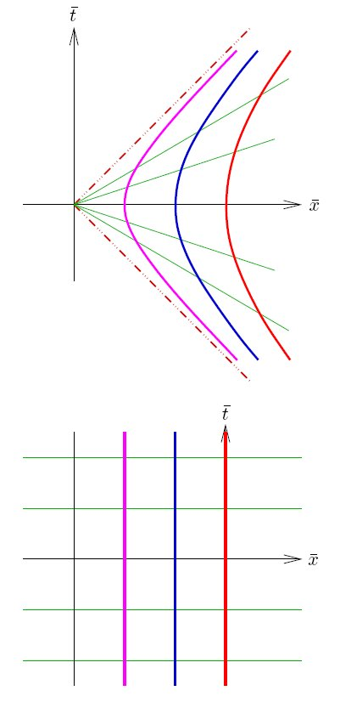
uniformly accelerated observers
Result of the general recipe
Notes:
Natural coordinate system of a uniformly accelerated observer.

Slide 55
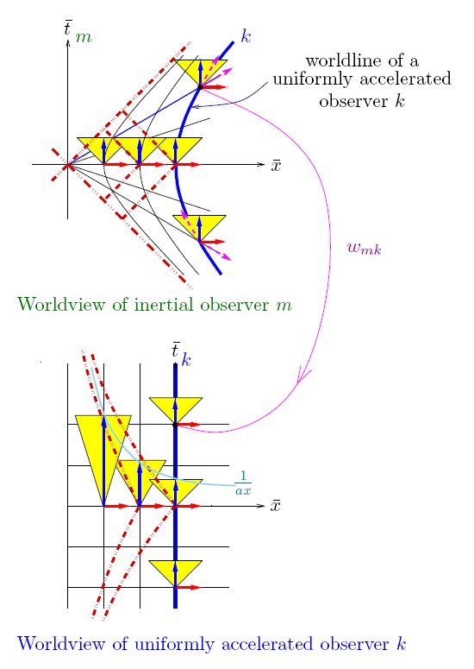
uniformly accelerated observers
Notes:
Constructing the spacetime of a BH by studying accelerated spacefleets
The theory of accelerated spacefleets leads up to understanding the spacetime geometry of BH’s
Event horison. Time slows down near the event horison.
Light-cones close up

Slide 56
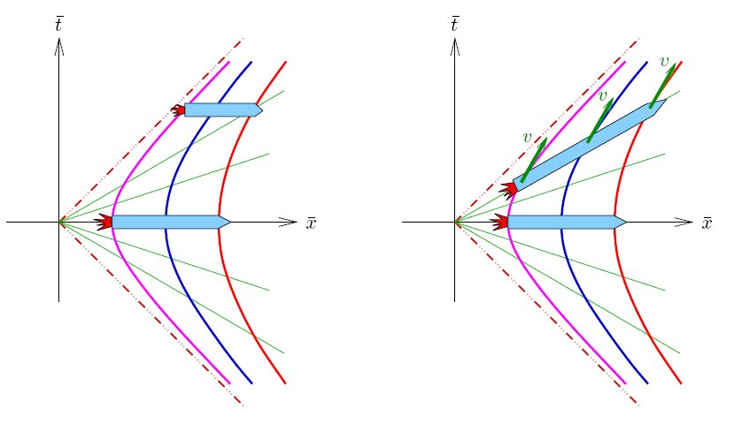
uniformly accelerating spaceship
outside view
inside view
Notes:
Shows that fast moving spaceship shrinks! Captain thinks it does not.
We can imagine a fleet of spaceships instead of a single huge one.
View from inside: fleet does not shrink. View from ourside: fleet shrinks.
Cause: relativity of simultaneity.

Slide 57
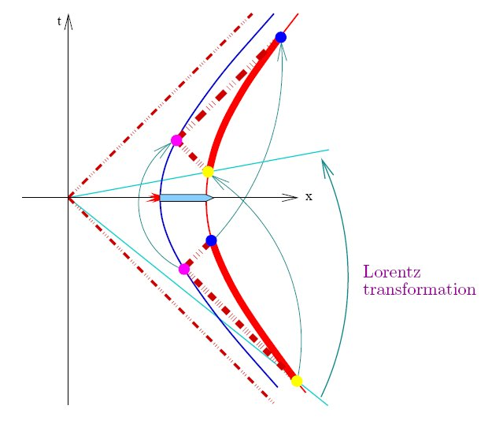
uniformly accelerating spaceship
1. Length of the ship does not change seen from inside.
Captain measures length of his ship by radar:
Notes:
Proof that radar distance between nose and rear of ship stays constant.

Slide 58
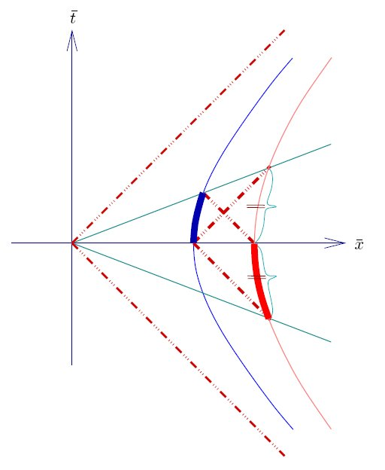
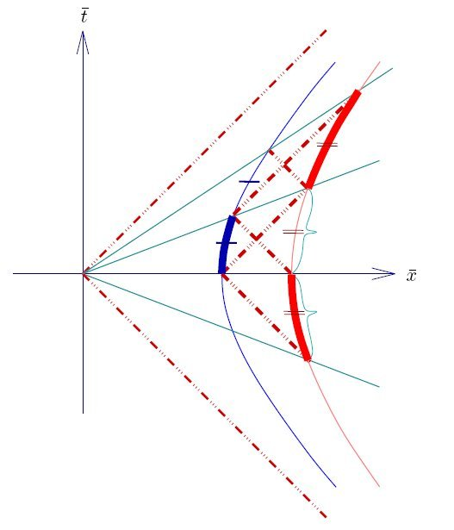
uniformly accelerating spaceship
2. Time runs slower at the rear of the ship, and faster at the nose of ship.
Measured by radar:
Notes:
Cause of slow time is tilting of radar simultaneity.
Rear and nose see both, by spyglasses ie by photons, that time is slower at rear than at nose.

Slide 59



Gravitiy causes slow time
via Einstein’s Equivalence Principle
Notes:
Experiments in accelerated ship are the same as in the ship (tower) resting in the Earth.
Apple falls in former because of acceleration, falls in second because of gravity.
We proved that time is slower at rear of ship, so by equivalence principle, time will be slower at bottom of tower. Indeed this has been measured so.

Slide 60
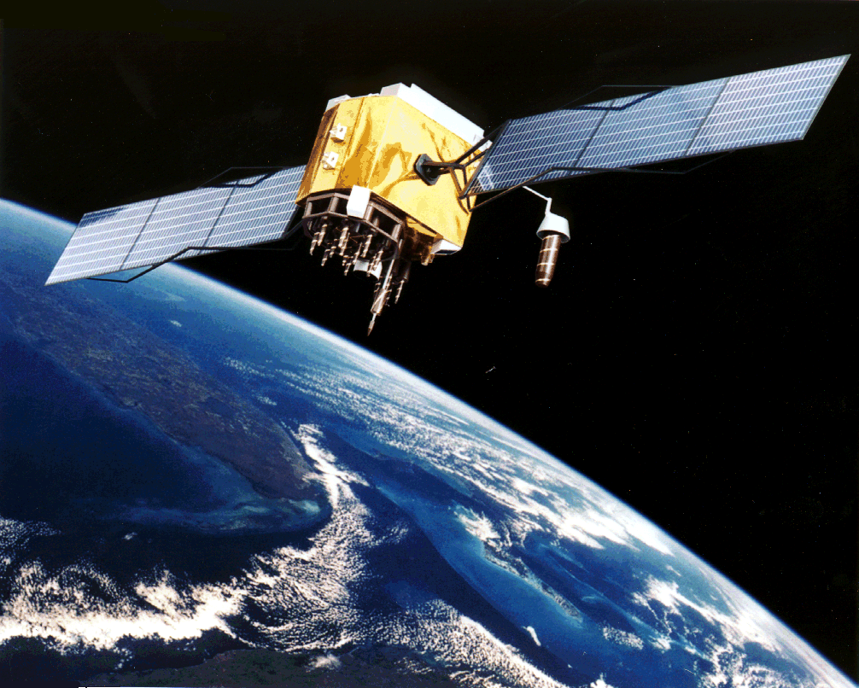
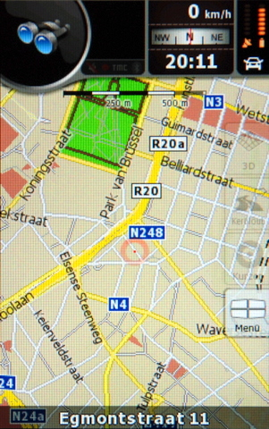
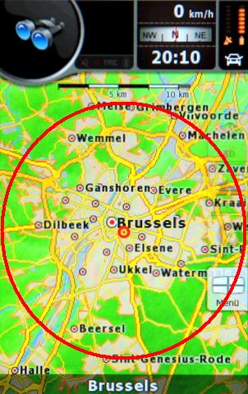
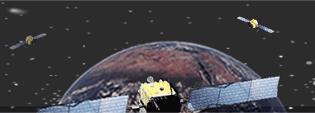
Everyday use of relativity theory
GPS
Global Positioning System
Relativistic Correction:
38 μs/day approx. 10 km/day
-7 μs/day because of the speed of sat. approx. 4 km/s (14400 km/h)
+45 μs/day because of gravity
Notes:
GTD is used and experienced in our everyday life!!!!

Slide 61
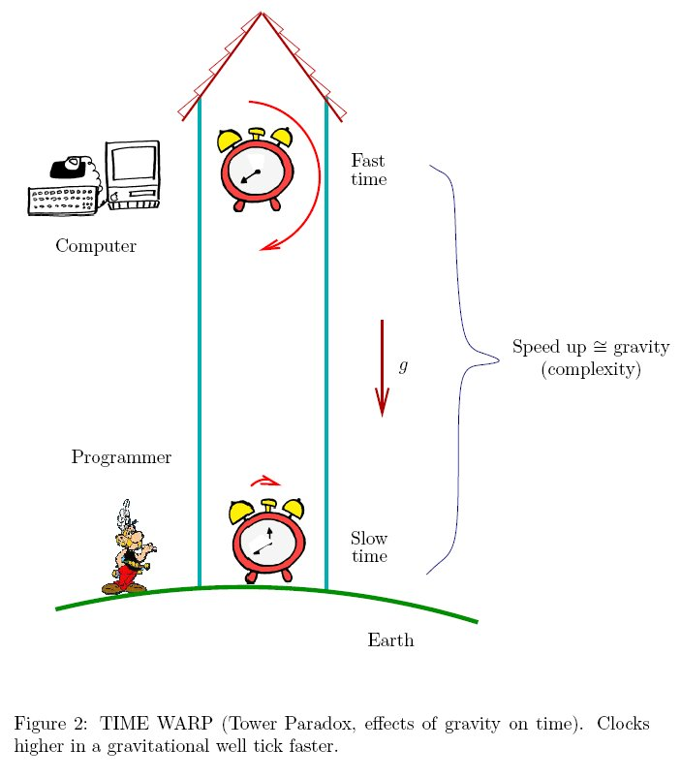
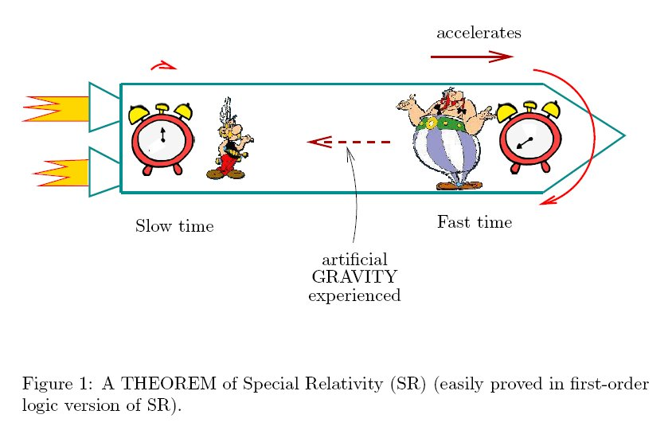
Gravitiy causes slow time
via Einstein’s Equivalence Principle
Notes:
Gravitational redshift

Slide 62
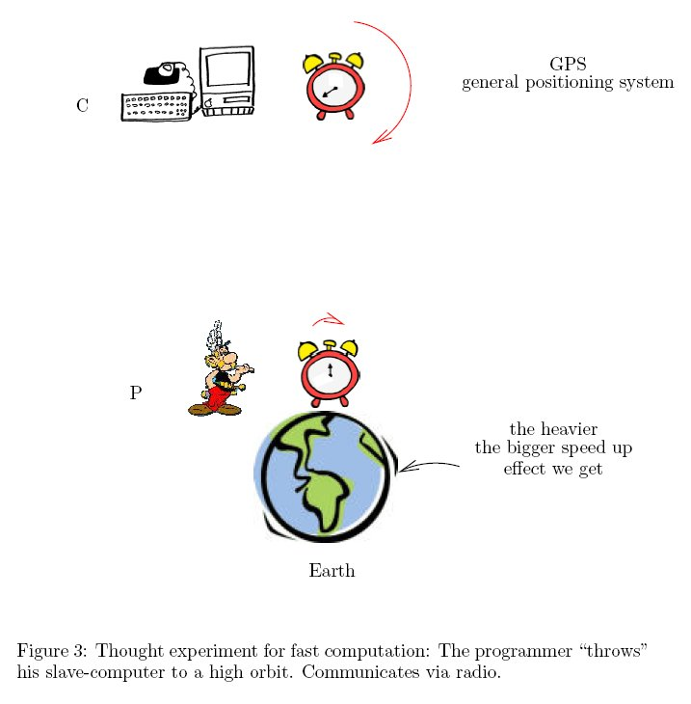
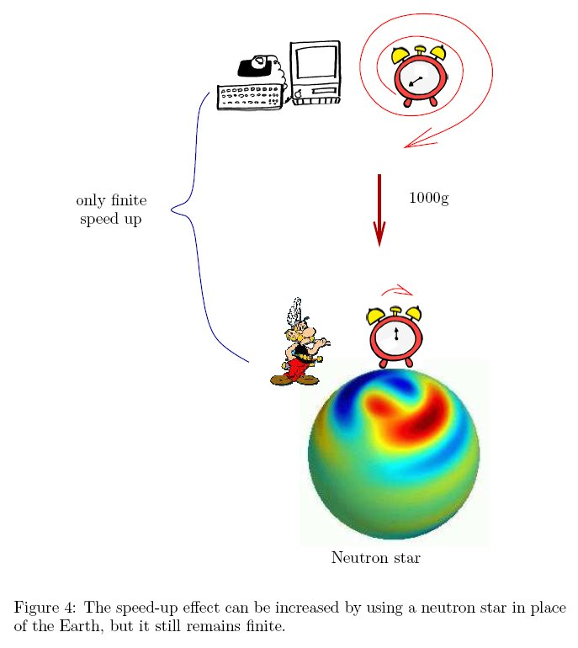
Gravitiy causes slow time
via Einstein’s Equivalence Principle
Notes:
GPS: globar positioning system
-7 μs/day because of the speed of sat. (approx. 4 km/s)
+45 μs/day because of gravity
Sum: 38 μs/day which means approx. 10 km/day error

Slide 63
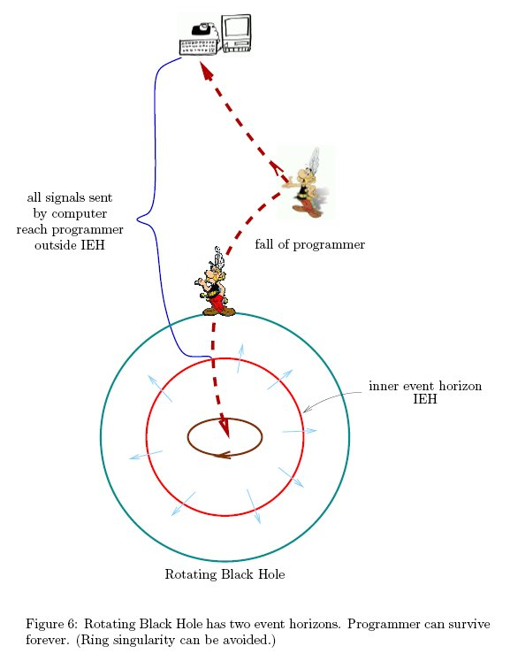
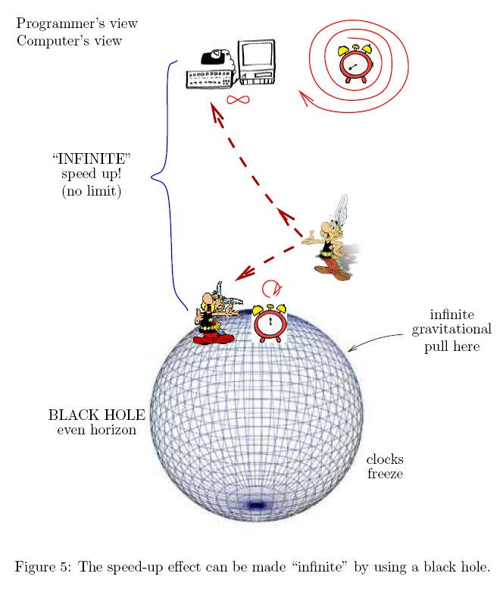
Gravitiy causes slow time
via Einstein’s Equivalence Principle
Notes:
With using a rotating BH one can decide whether set theory is consistent or not (by a concrete physical experiment, not by a thought experiment).
This is a feedback which logic and mathematics can get from GR. Actual infinity.

Slide 64
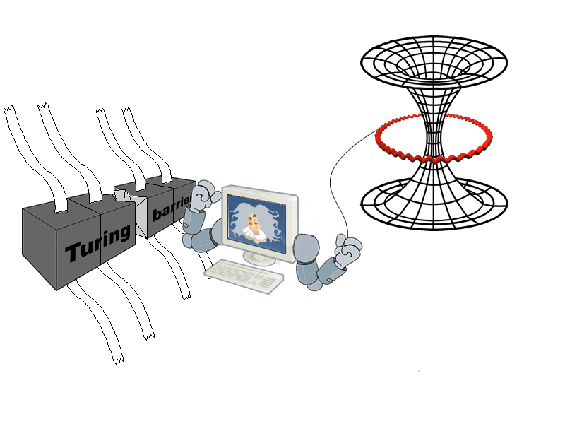
Application of GR to logic
Breaking the Turing-barrier via GR
Relativistic Hyper Computing
Notes:
This fits nicely into recent trend of broadening the notion of computability. See Barry Coopers talk.

Slide 65
accrel
Conceptual analysis of AccRel goes on …on our homepage
New theory is coming:

Slide 66

General relativity
Einstein’s strong Principle of Relativity:
“All observers are equivalent” (same laws of nature)
Abolish different treatment of inertial and accelerated observers in the axioms
G. R.
Notes:
French revolution abolishing the privileges of nobility

Slide 67
genrel
Language of GenRel: the same as that of SpecRel.
Recipe to obtain GenRel from AccRel: delete all axioms from AccRel mentioning IOb. But retain their IOb-free logical consequences.
AxSelf
AxPh
AxSymt
AxEv
AxSelf-
AxPh-
AxSymt-
AxEv-
AxCmv
AxDif
Notes:
We replace each axiom that mentions inertial observers with one that mentions only accelerated observers but which says roughly the same

Slide 68
Axioms for Genrel
mϵOb
1_{t}
1_{t’}
AxPh-
The velocity of photons an observer “meets” is 1 when they meet, and it is
possible to send out a photon in each direction where the observer stands
AxSym-
Meeting observers see each other’s clocks slow down with the same rate

Slide 69
genrel
GenRel =
AxField +AxPh⁻+AxEv⁻+ AxSelf⁻ +AxSymt⁻+AxDif+AxCont
Theorems
Thm1001
Thm1002
Thm1003
GenRel
AxField
AxPh⁻
AxEv⁻
AxSelf⁻AxSymt⁻
AxDif
AxCont
…
Proofs
Notes:
7 axioms

Slide 70

genrel
Thm1002
  GenRel is complete wrt Lorentz manifolds.
M=Events
k’
w_{k}
ev_{k}
L_{p}
k
p
Metric:
w_{km}
ev_{m}
w_{m}
Manifold
Notes:
Analogous with the completeness proof of SpecRel.

Slide 71
uniformly accelerated observers
Notes:
This is an example of a Lorentz manifold

Slide 72
Genrel
  How to use GenRel?
  Recover IOb’s by their properties
  In AccRel by the “twin paradox theorem”
  IOb’s are those observers who maximize wristwatch-time locally
  Recover LIFs
Notes:
Competing curves
Geodesic motion ≡ inertial motion
Predicts gravitational falling of test particles
Local Inertial Frames or Local Inertial Coordinate systems/world-views

Slide 73
genrel
Timelike means: exist comoving observer

Slide 74

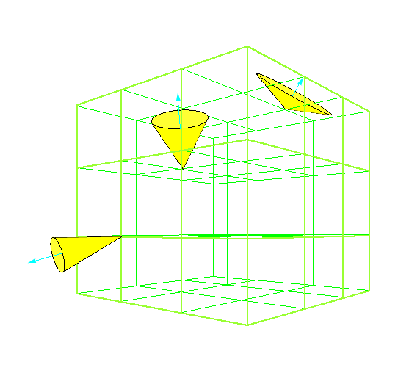
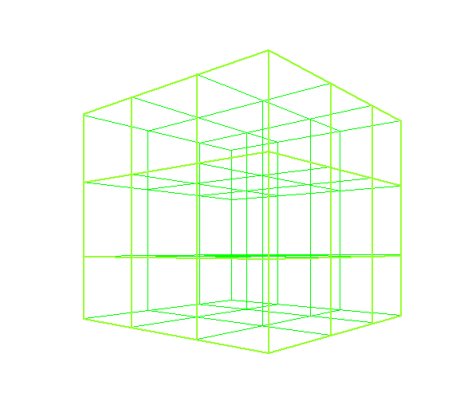
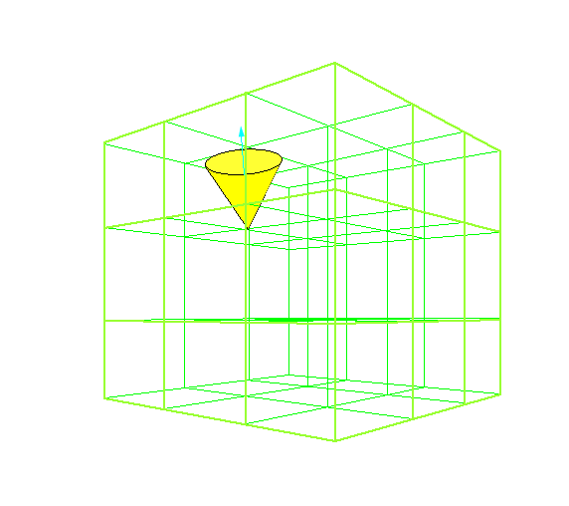
Specifying a genrel space-time

Slide 75
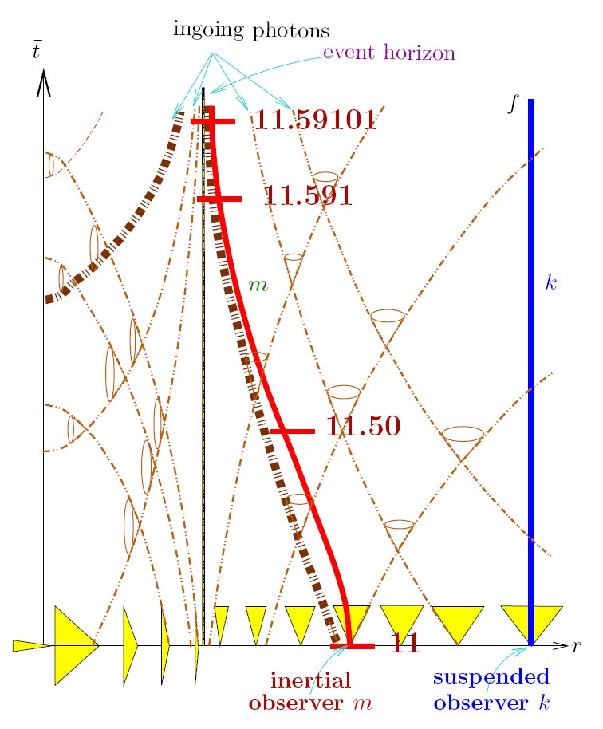
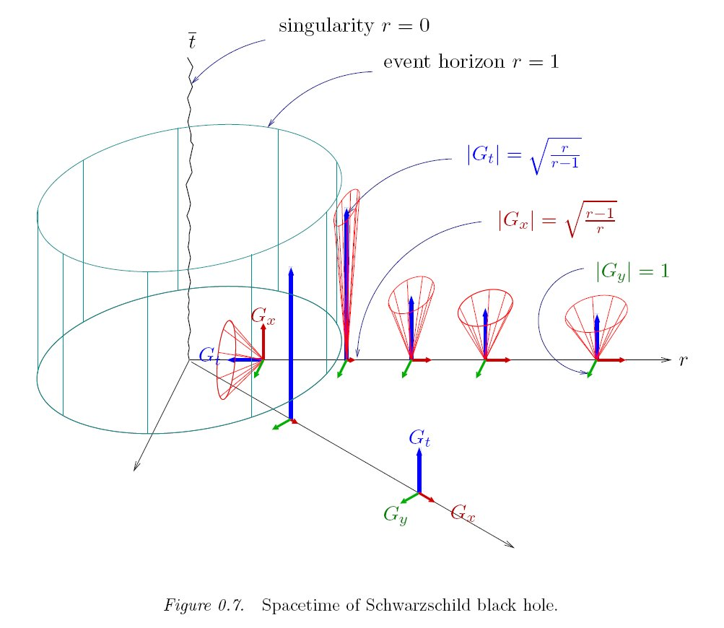
Examples for genrel spacetimes

Slide 76
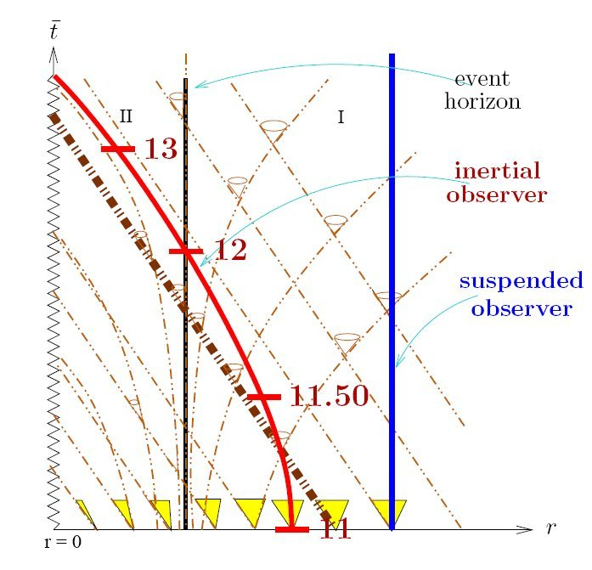
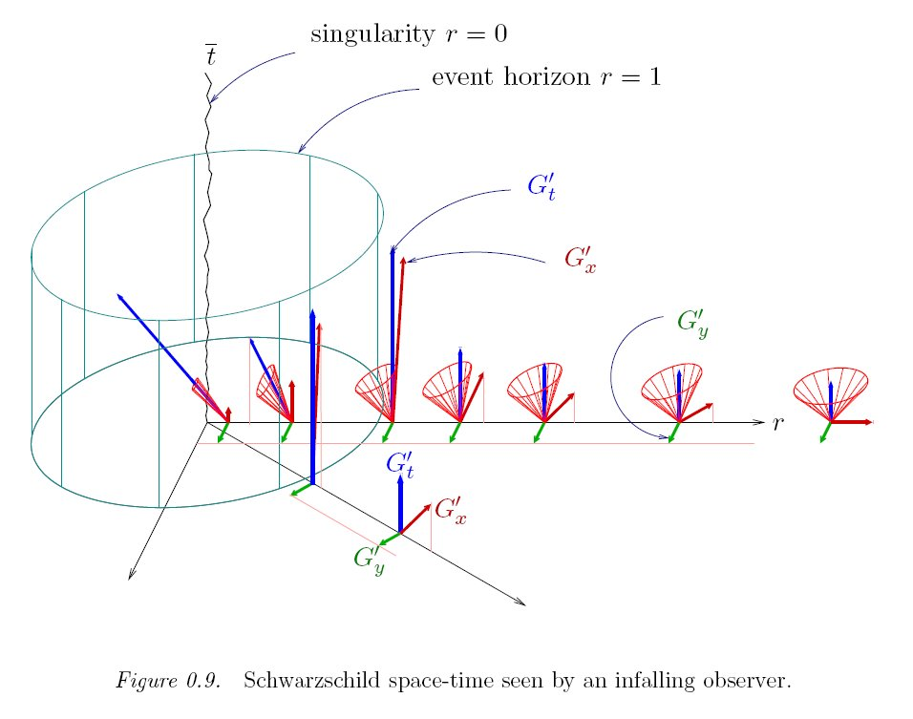
Examples for genrel spacetimes

Slide 77
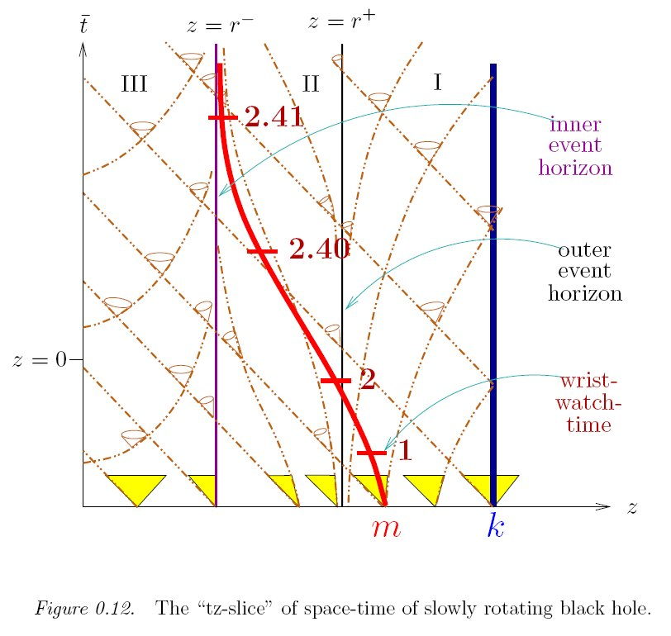
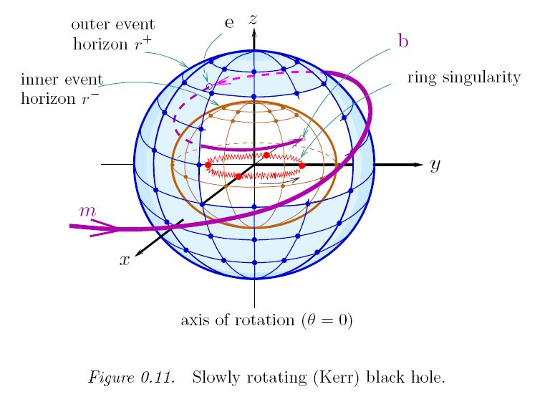
Examples for genrel spacetimes

Slide 78
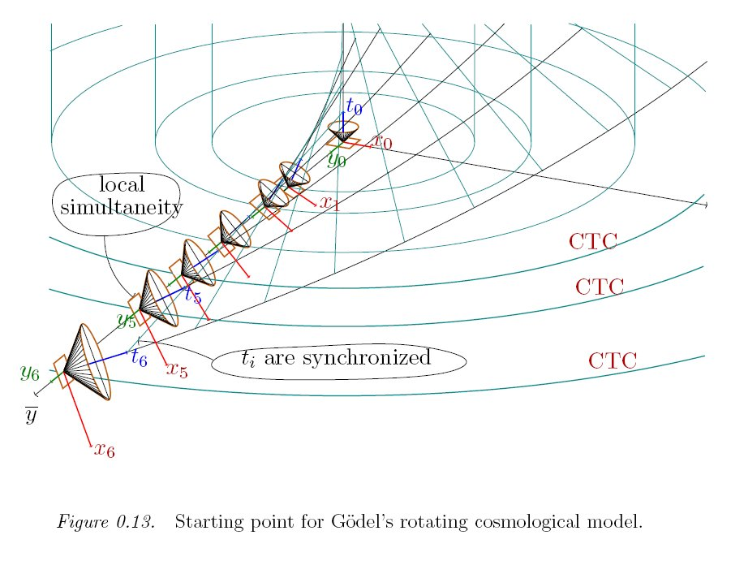
Examples for genrel spacetimes

Slide 79
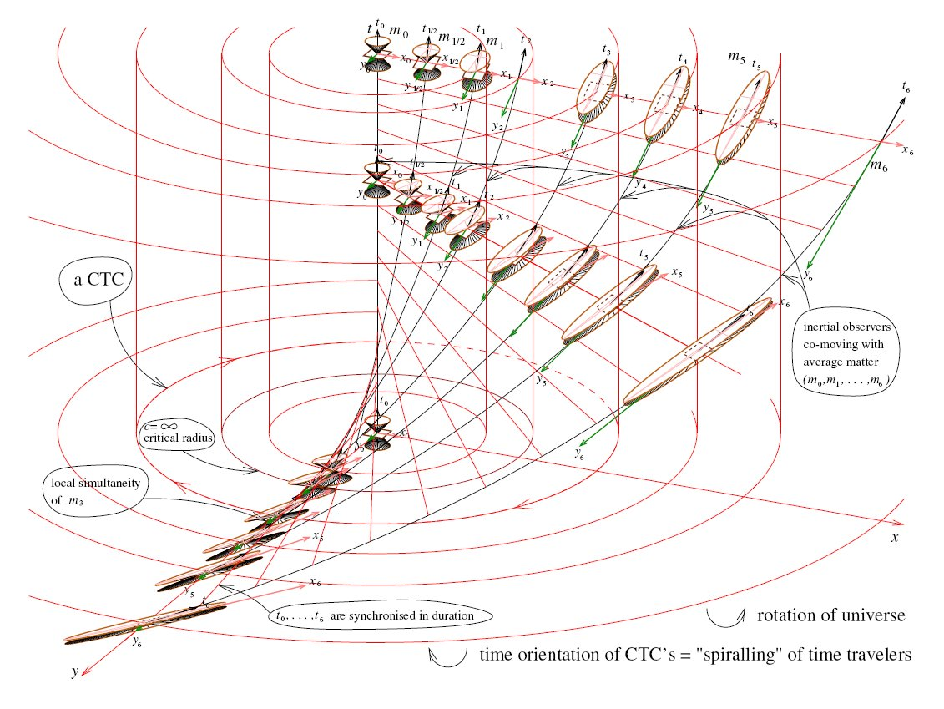
Examples for genrel spacetimes
Lightcones open up.
More in our papers in General Relativity and Gravitation 2008 & in arXiv.org 2008
Notes:
Timetravel is possible in the direction opposite to that of rotation of matter.

Slide 80
publications
More concrete material available from our group:
(1) Logic of Spacetime
http://ftp.math-inst.hu/pub/algebraic-logic/Logicofspacetime.pdf
(2) in Foundation of Physics
http://ftp.math-inst.hu/pub/algebraic-logic/twp.pdf
(3) First-order logic foundation of relativity theories
http://ftp.math-inst.hu/pub/algebraic-logic/springer.2006-04-10.pdf
(4) FOL 75 papers
http://www.math-inst.hu/pub/algebraic-logic/foundrel03nov.html
http://www.math-inst.hu/pub/algebraic-logic/loc-mnt04.html
(5) our e-book on conceptual analysis of SpecRel
http://www.math-inst.hu/pub/algebraic-logic/olsort.html
(6) More on István Németi's homepage http://www.renyi.hu/~nemeti/
(Some papers available, and some recent work)
Thank you!

